Slide 1


westsussex.gov.uk/virtualschool
PEP Questions with Symbols
Editable PowerPoint
West Sussex Virtual School

Slide 2

Please choose a question set to use with your young person and tailor it to the setting and their educational experience.
Recording Answers – please choose from these two options:
Add to the PowerPoint and upload to ePEP. When uploading, please label the document “Young Person’s Voice” with the term and year. Pictures and symbols can be pasted onto the slides by the key adult or the young person. Responses can also be scribed in the green text box.
Scribe the Young Person’s answers into the boxes on the Questionnaire on ePEP. It is also helpful to record the method of communication used by the young person – eg pointing, spoken language, Makaton, eye-gaze technology etc.
Personal Education Plans (PEPs) for Children We Care For are completed through ePEP, an electronic system commissioned by West Sussex provided by eGov Digital.
Virtual School
westsussex.gov.uk/virtualschool

Slide 3
Question Set Slide numbers
Set 1 4 – 11
Set 2 12 – 20
Set 3 (Not currently in education) 21 - 29
Please choose the question set that works best for your young person
Virtual School
westsussex.gov.uk/virtualschool

Slide 4
Question Set 1

Slide 5


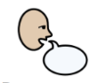
Response:
5
Question 1

Slide 6

Response:
6
Question 2

Slide 7

Response:
Question 3

Slide 8

Response:
Question 4

Slide 9

Response:
Question 5

Slide 10
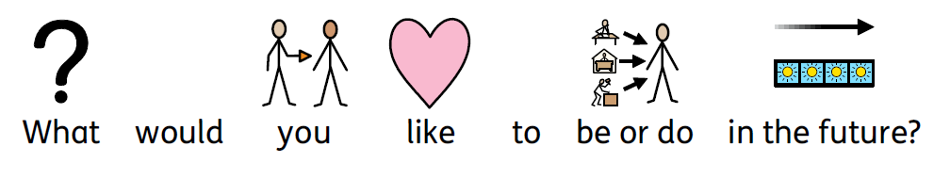
Response:
Question 6

Slide 11
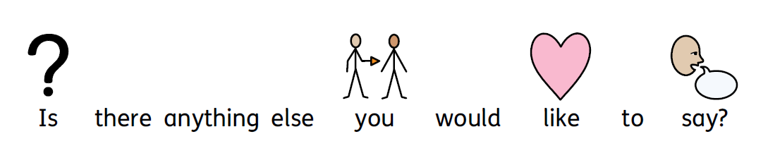
Response:
Question 7

Slide 12
Question Set 2

Slide 13

Response:
Question 1

Slide 14
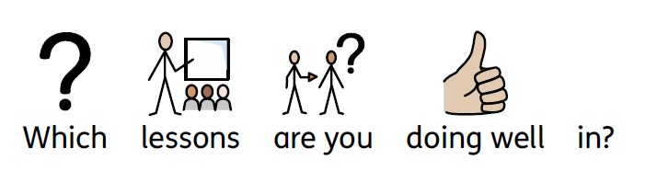
Response:
Question 2

Slide 15

Response:
Question 3

Slide 16
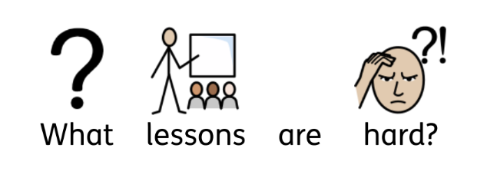
Response:
Question 4

Slide 17

Response:
Question 5

Slide 18

Response:
Question 6

Slide 19
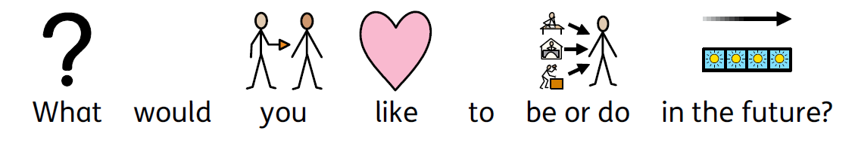
Response:
Question 7

Slide 20
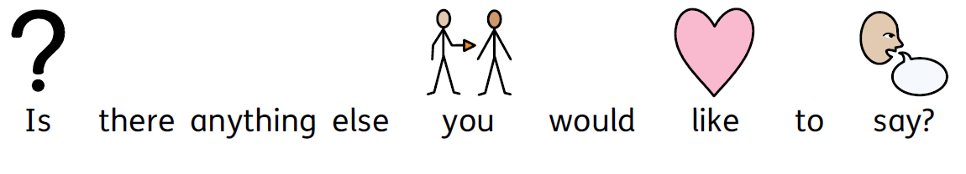
Response:
Question 8

Slide 21
Question Set 3
(Not in Education)

Slide 22
Response:
Question 1

Slide 23

Response:
Question 2

Slide 24

Response:
Question 3

Slide 25

Response:
Question 4

Slide 26

Response:
Question 5

Slide 27

Response:
Question 6

Slide 28
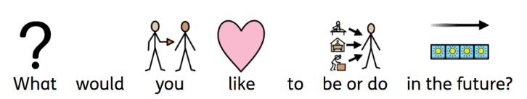
Response:
Question 7

Slide 29
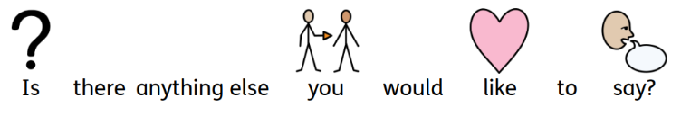
Response:
Question 8

