Slide 1
Woodlands Meed College

Slide 2
Agenda
Introduction and Housekeeping
Background to the Project
The Main Parties
The Design and Construction Team
The Design
Project Programme
Summary
Questions
Closing Comments

Slide 3
Introduction and Housekeeping

Slide 4
Background to the Project

Slide 5
The Main Parties
Woodlands Meed Governors: Represent the interest of the students at Woodland's Meed
West Sussex County Council: Contracting Authority for all stages of the Design/Construction.
Faithful+Gould: Provide design expertise to WSCC
ISG: Main contractor and also responsible for design from RIBA Stage 3.

Slide 6
The Design and Construction Team
Haverstock – led the design until the appointment of ISG.
Experienced designer with significant experience in the SEND/Special Schools
ISG: Main contractor with responsibility for design (incorporating Haverstock).
Experienced contractor especially within the SEND sector

Slide 7
The Design

Slide 8
Scheme developed with WMC
Design complies with relevant standards
Complies with Building Bulleting 104 with exceptions covered by derogations
Derogations are required due to college requirements, site orientation/level changes, changes to standards etc.
Example of a derogation is a change in the building control system or where a new standard supersedes the requirements of the design guide.

Slide 9
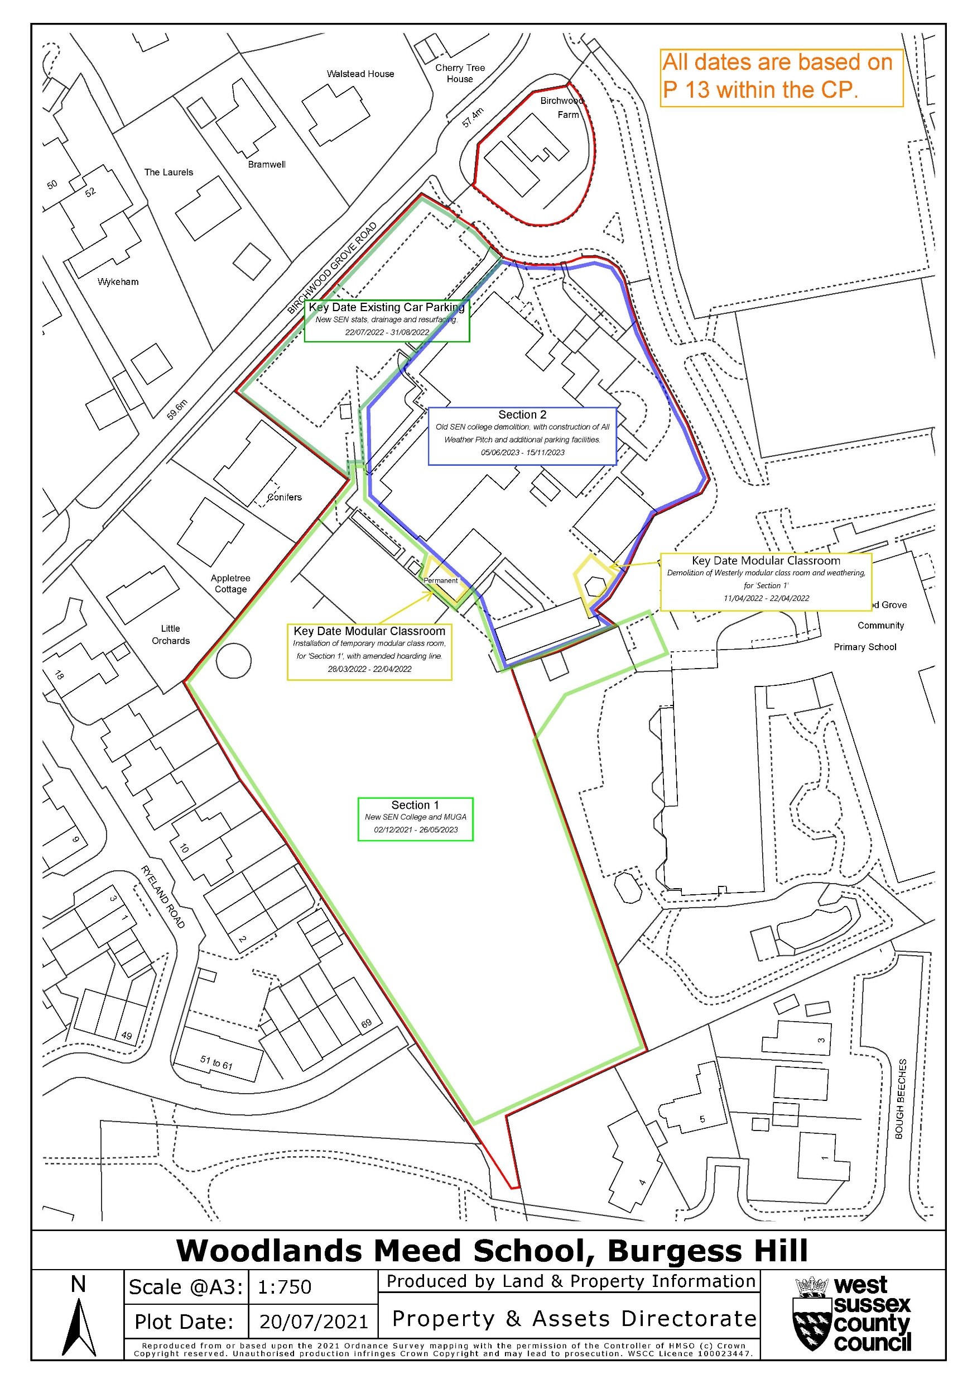

Slide 11
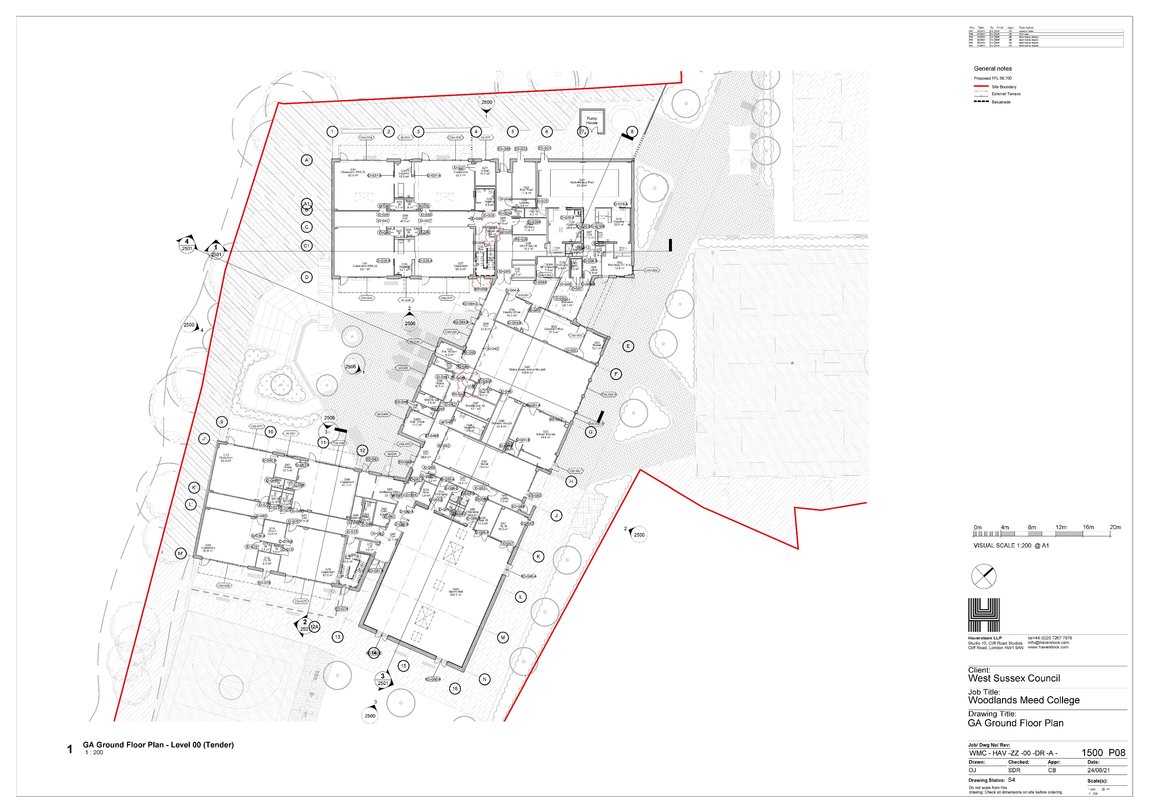

Slide 12
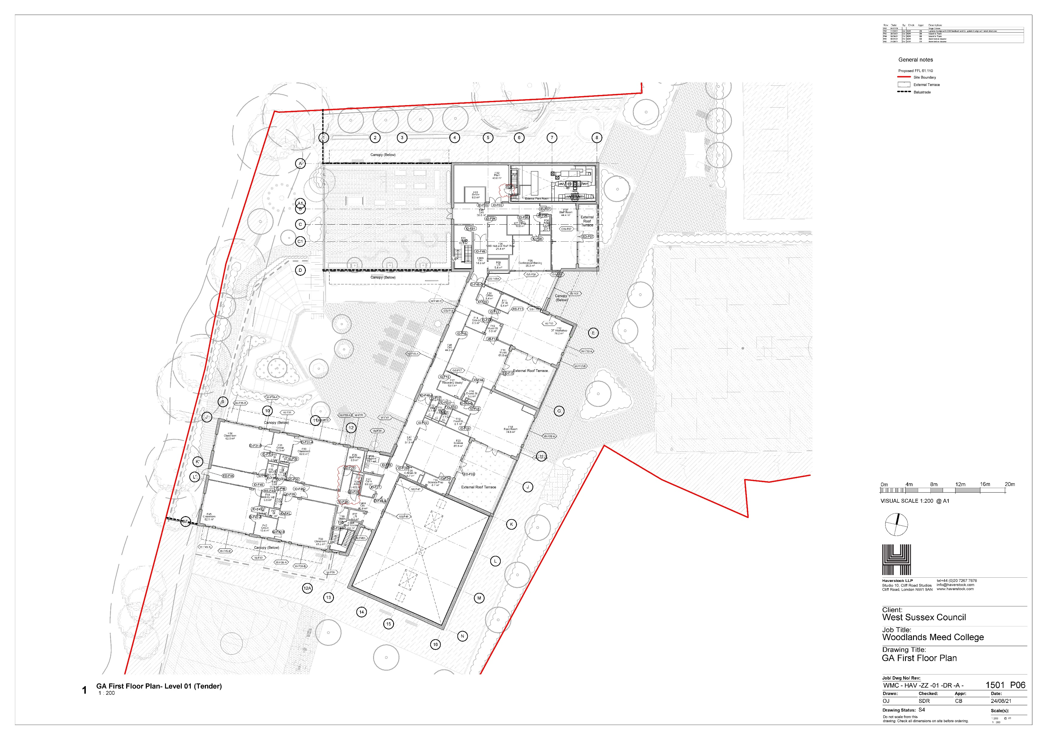

Slide 13
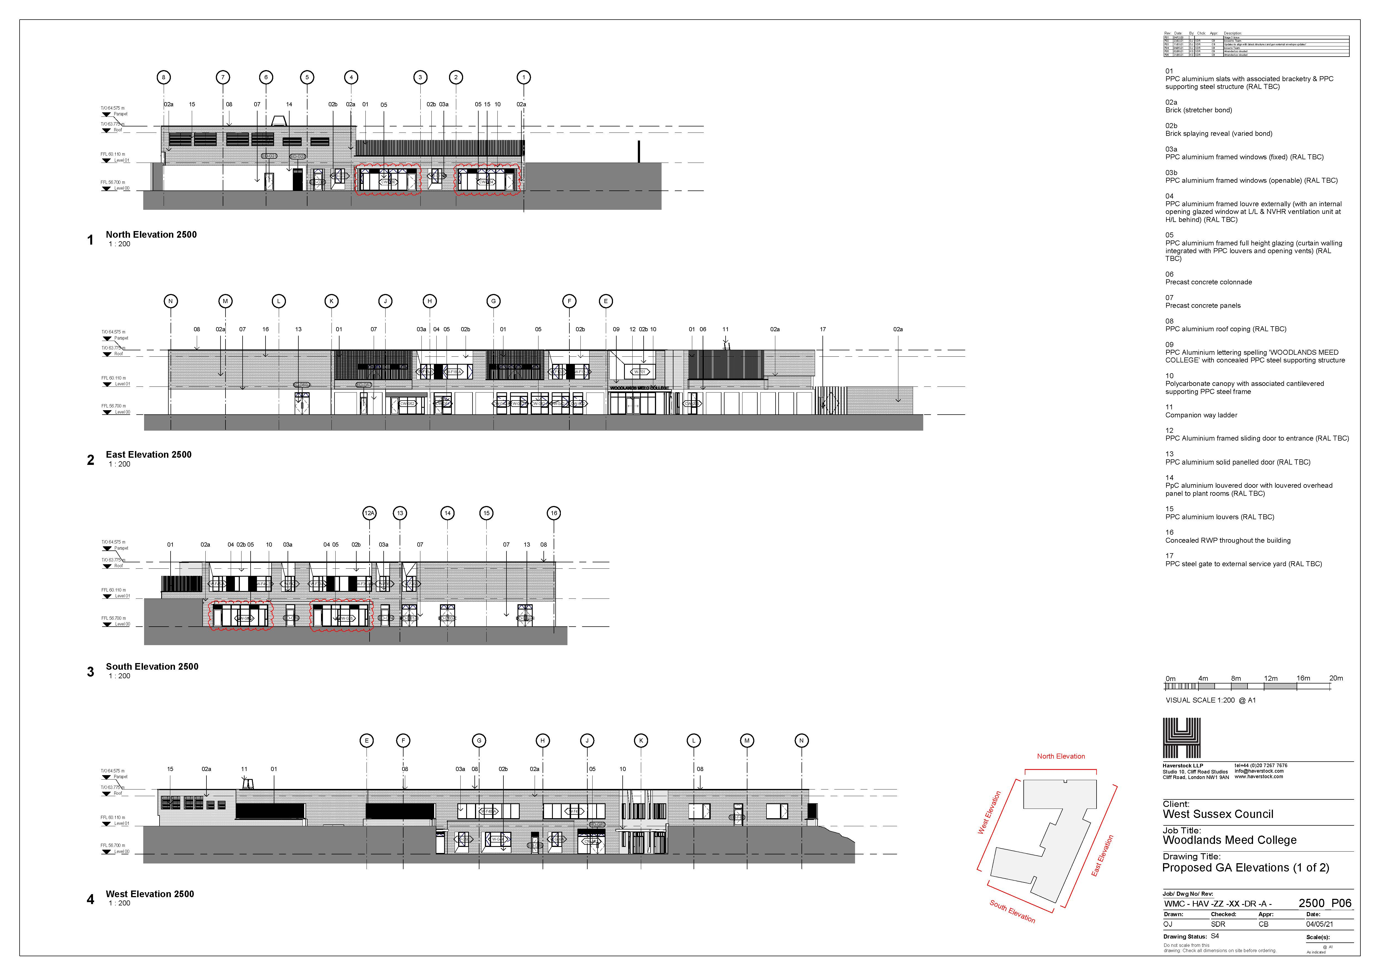

Slide 14
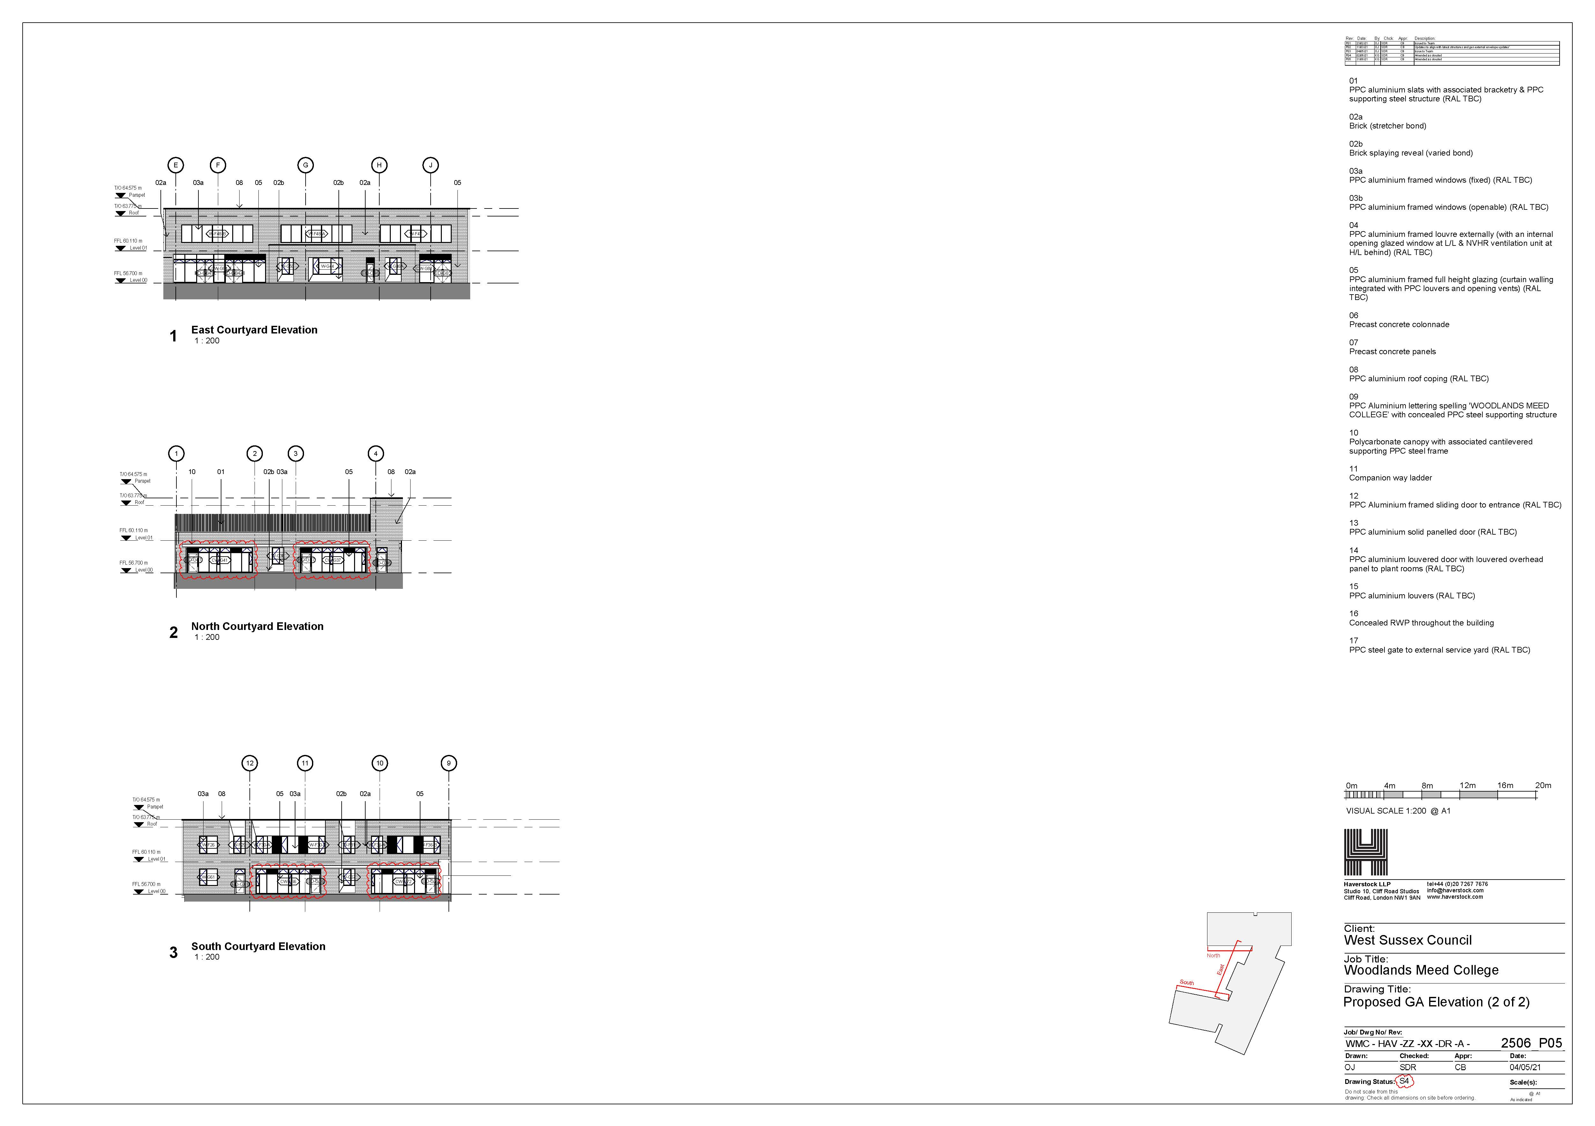

Slide 15
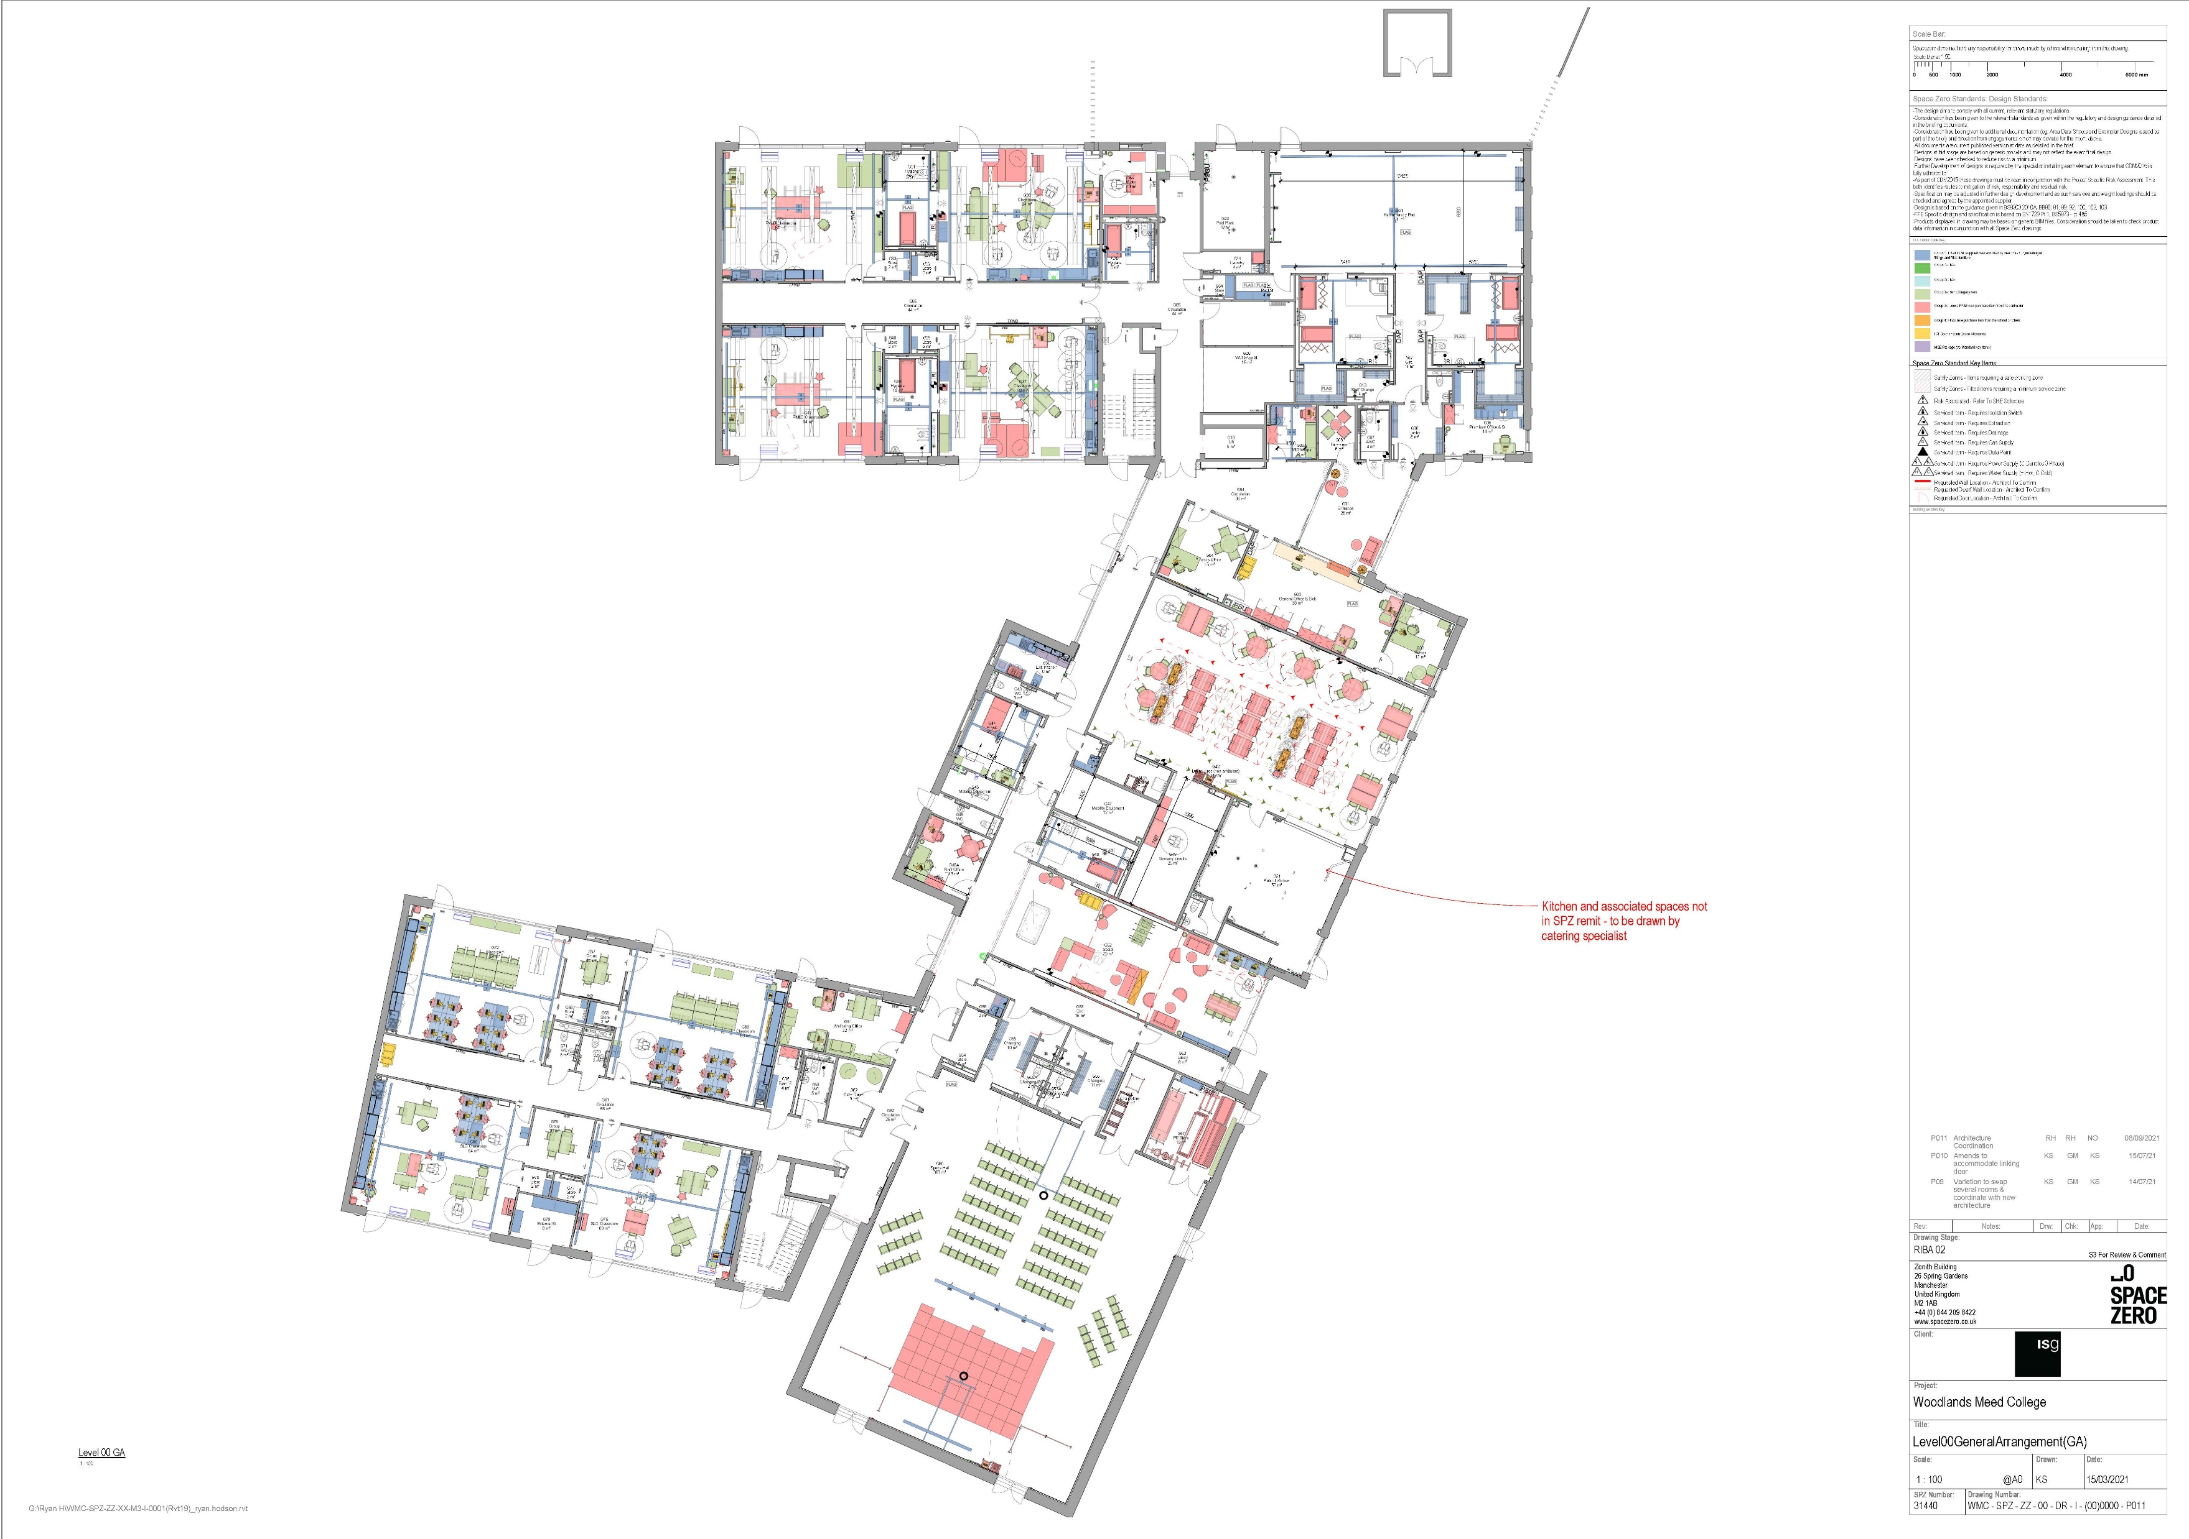

Slide 16
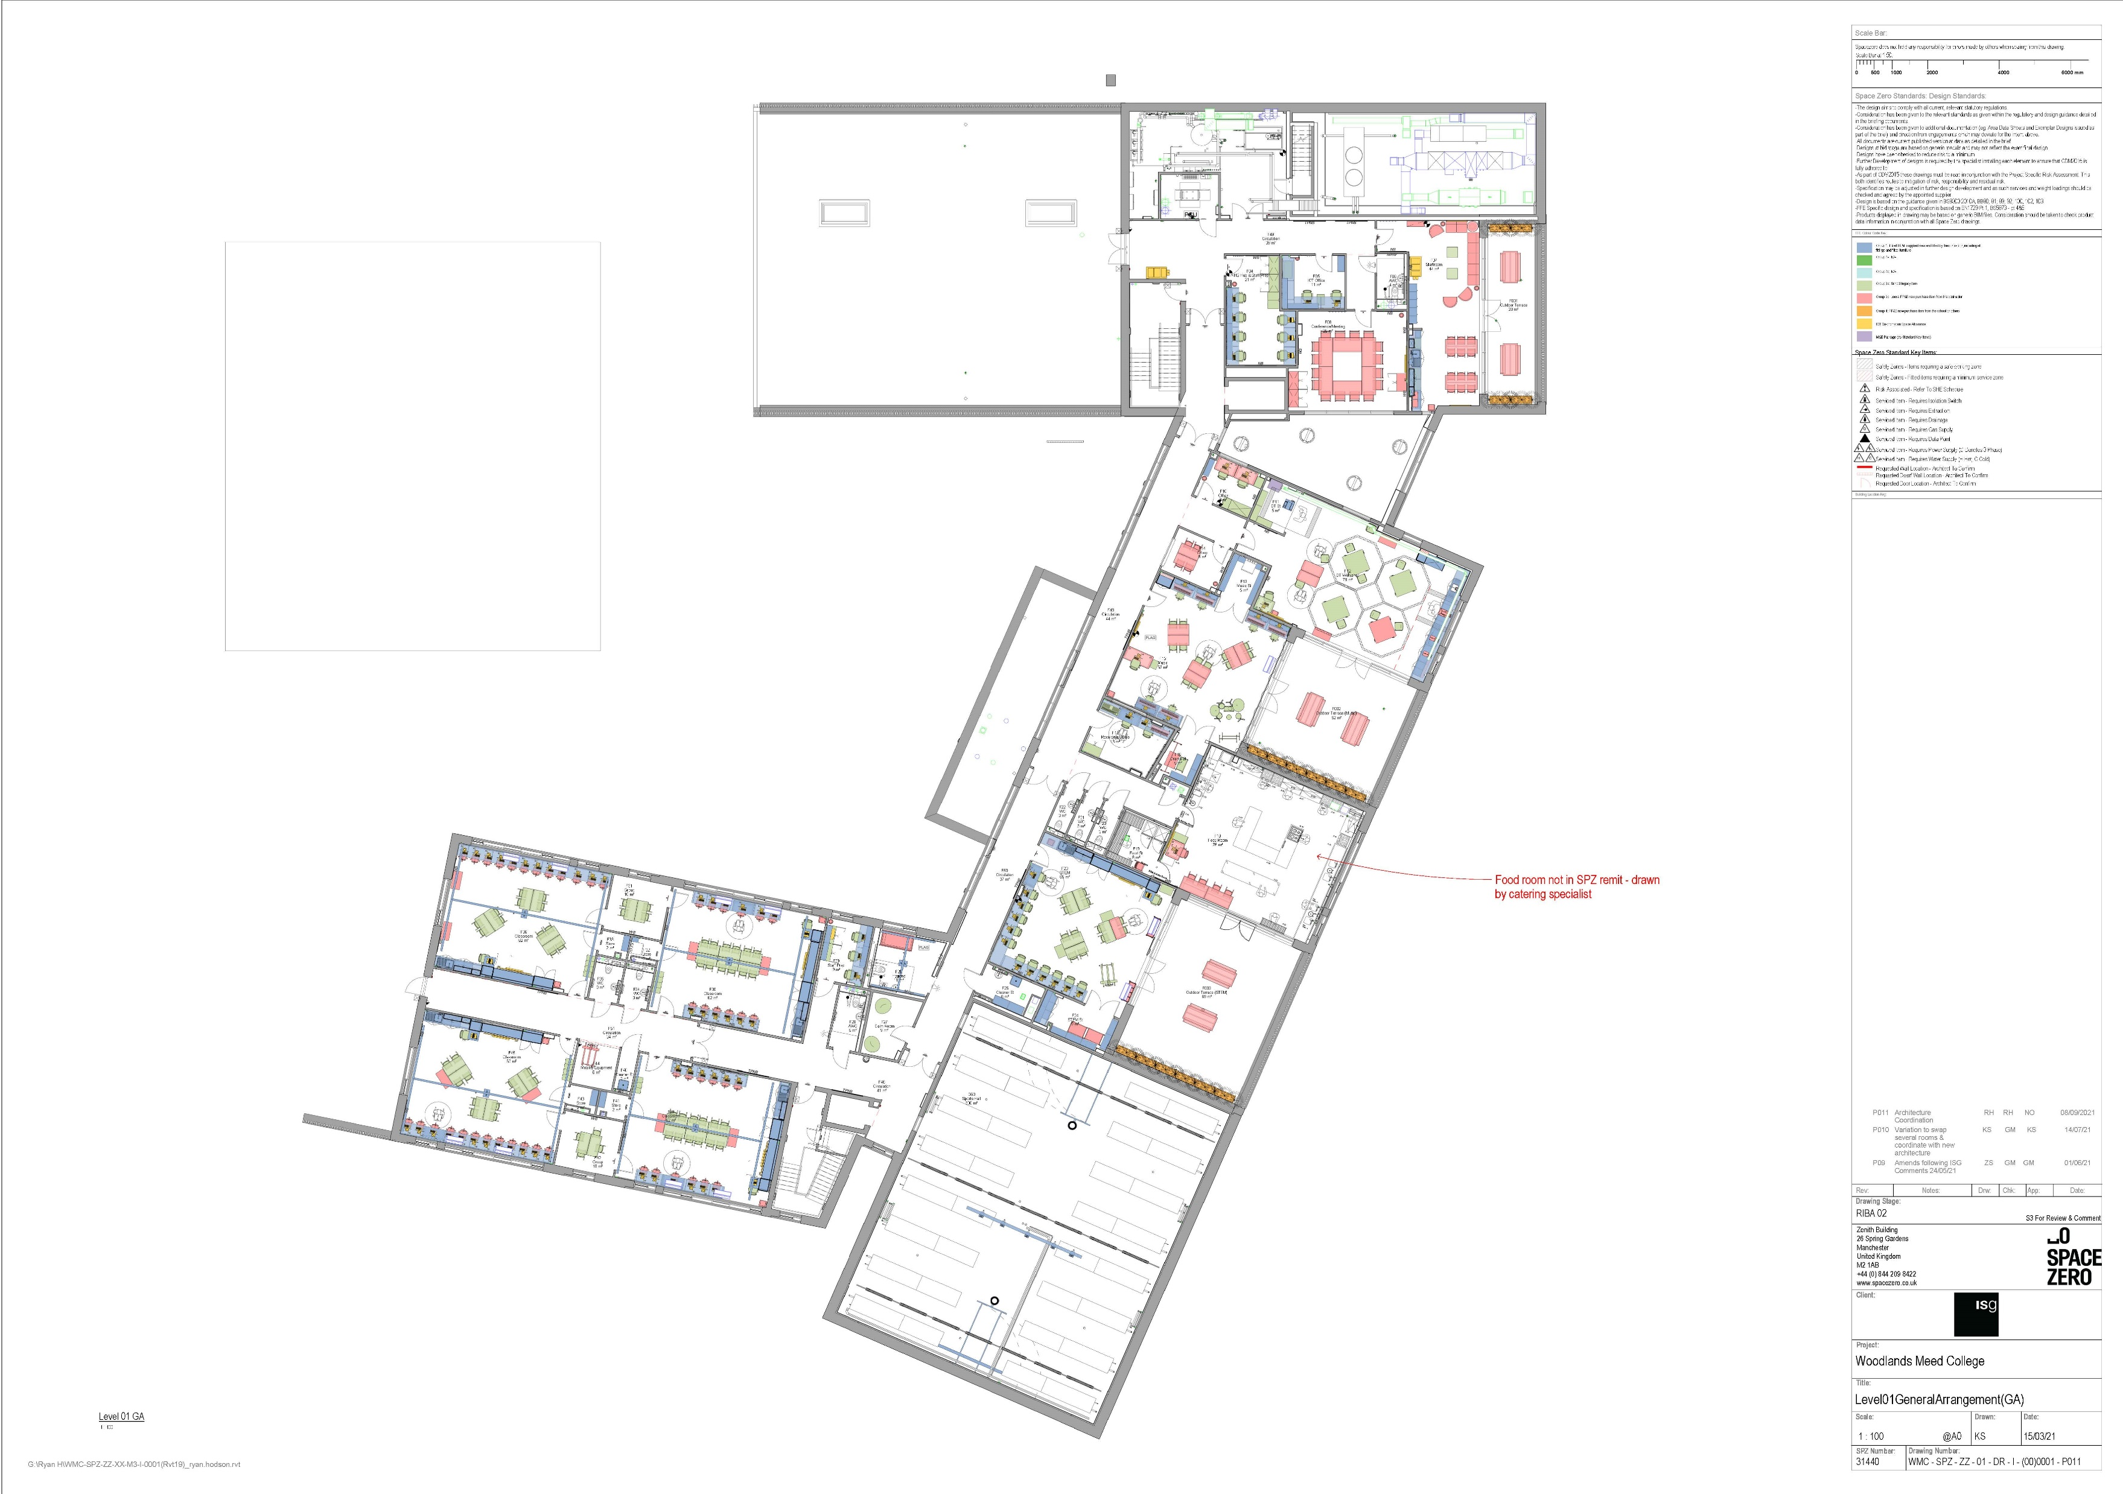

Slide 17
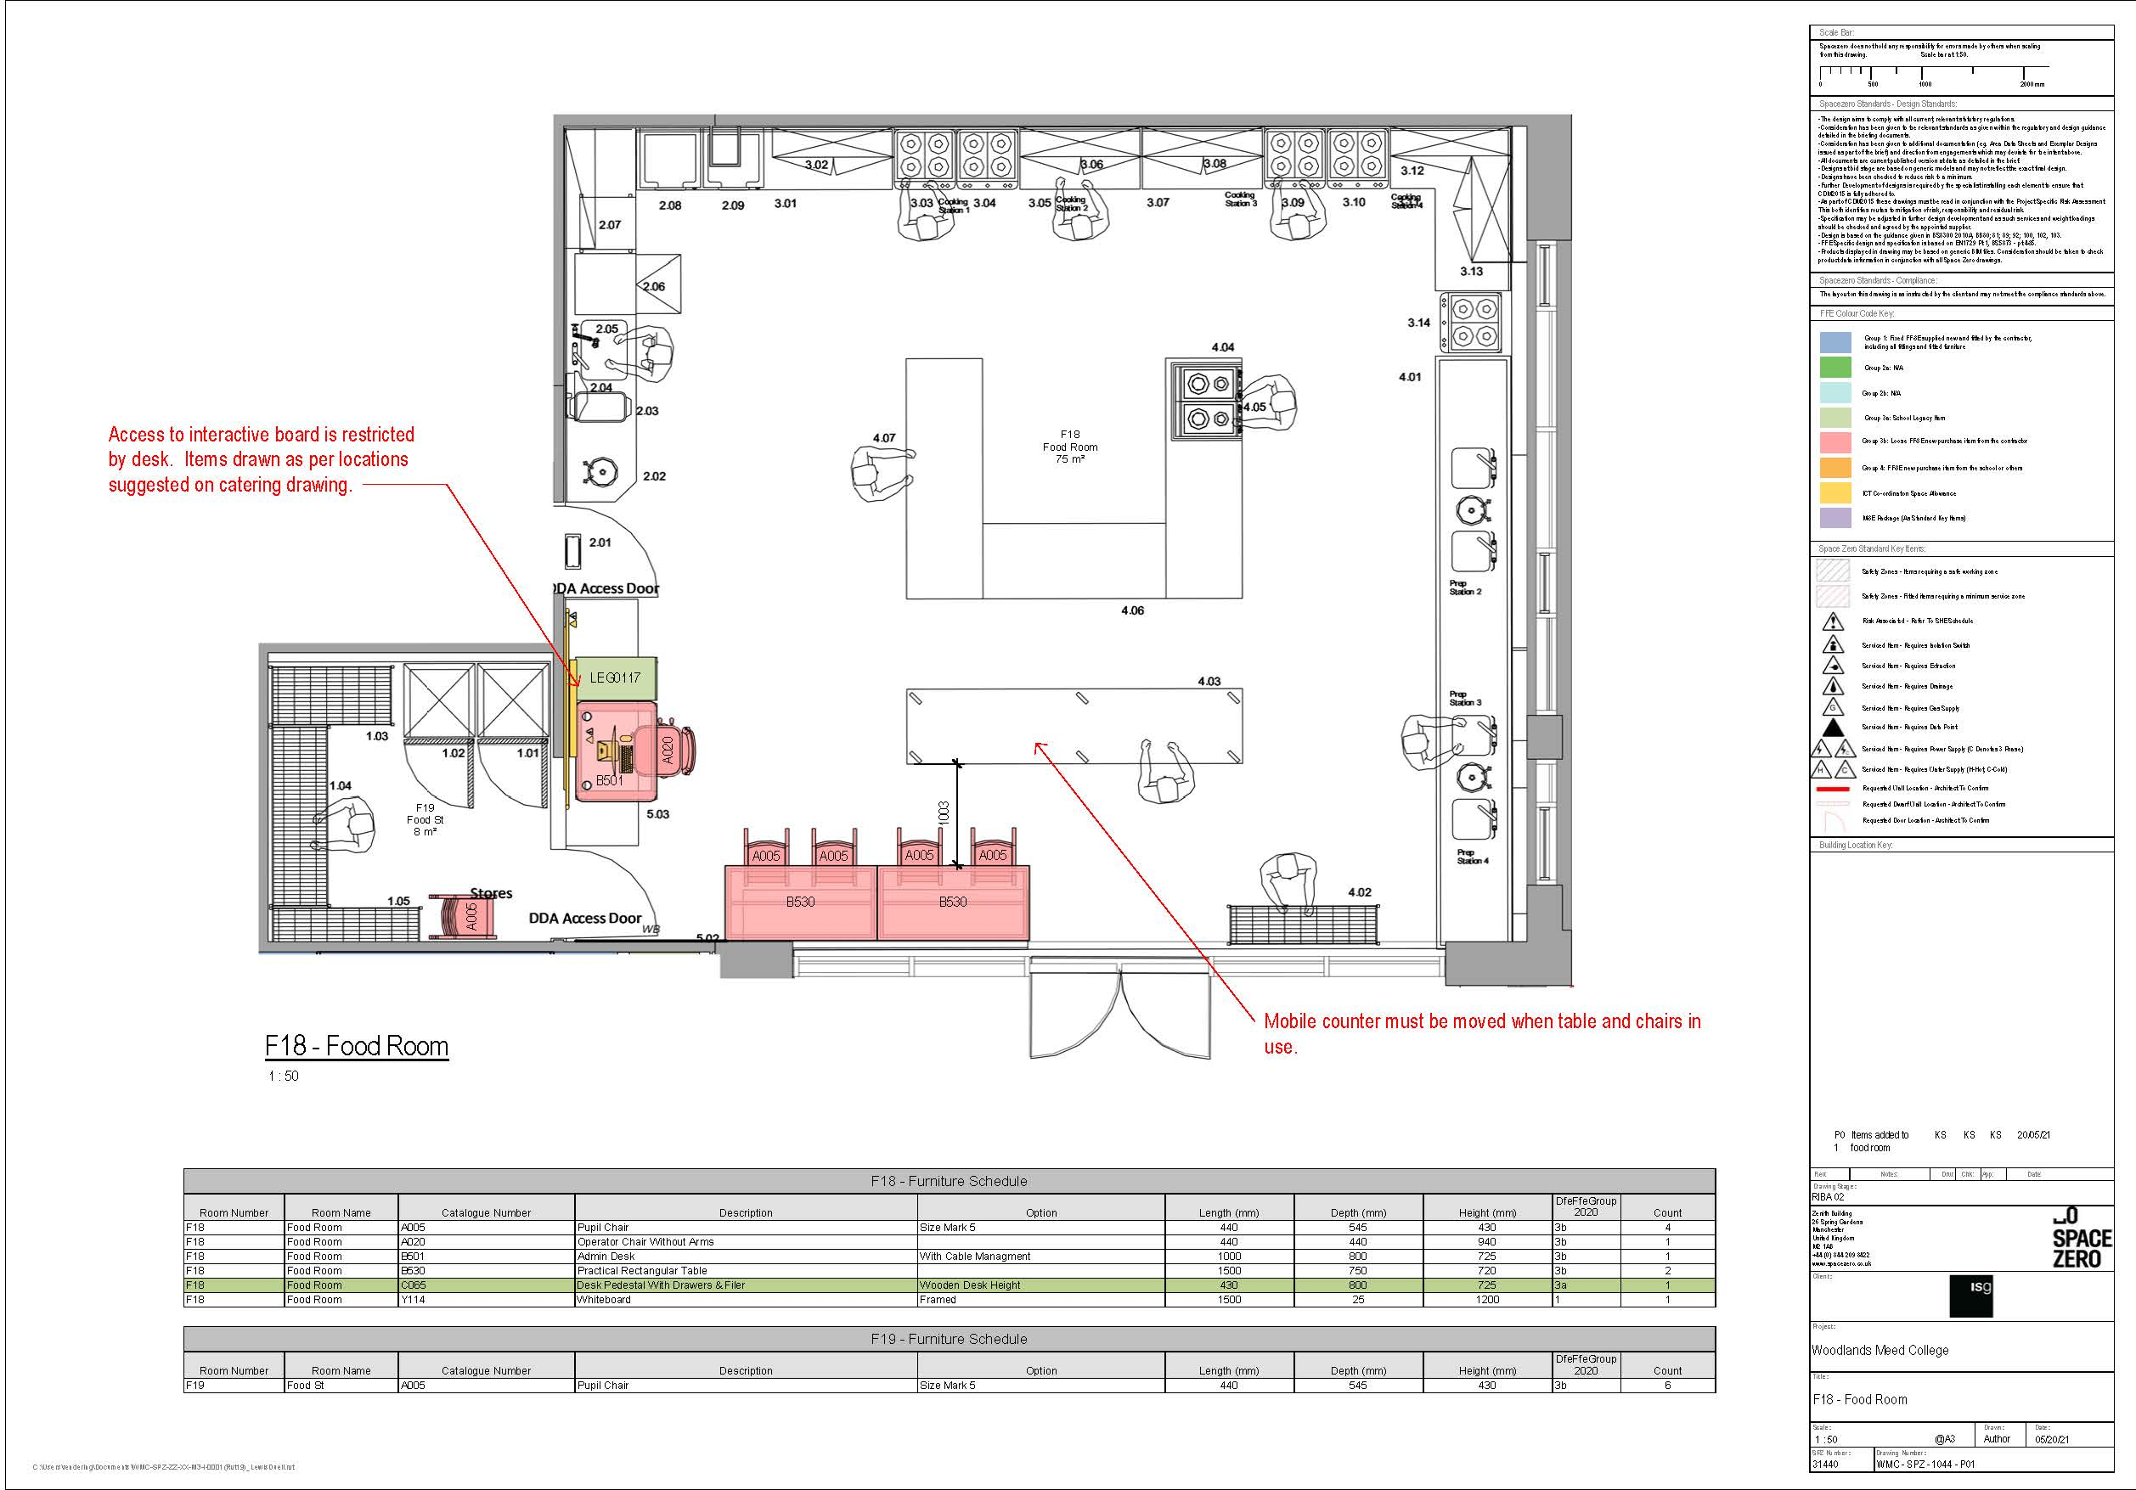
Food Technology

Slide 18
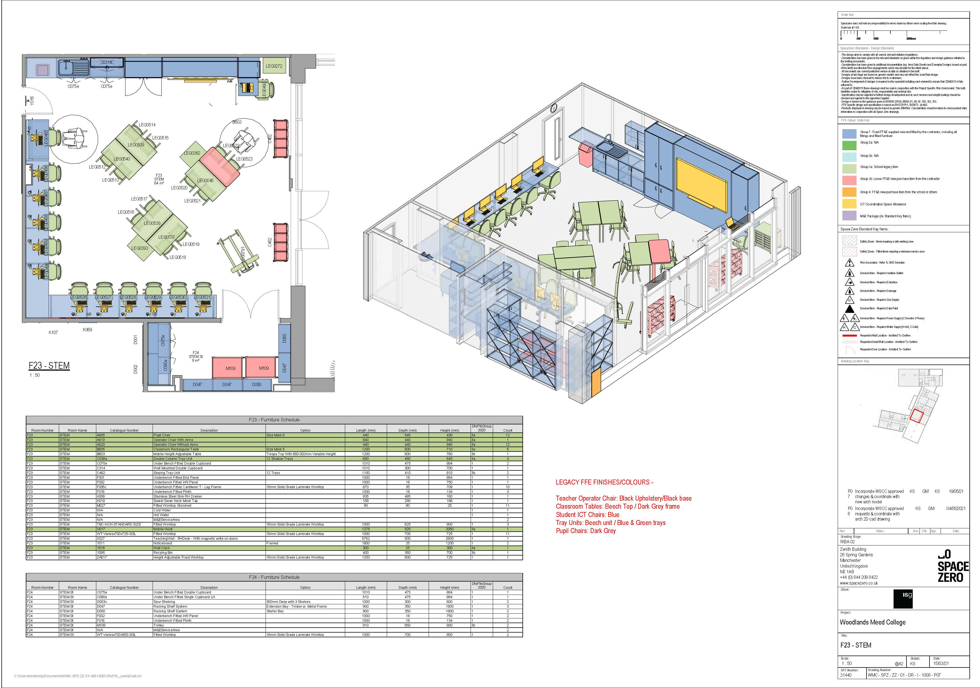
STEM Room

Slide 19
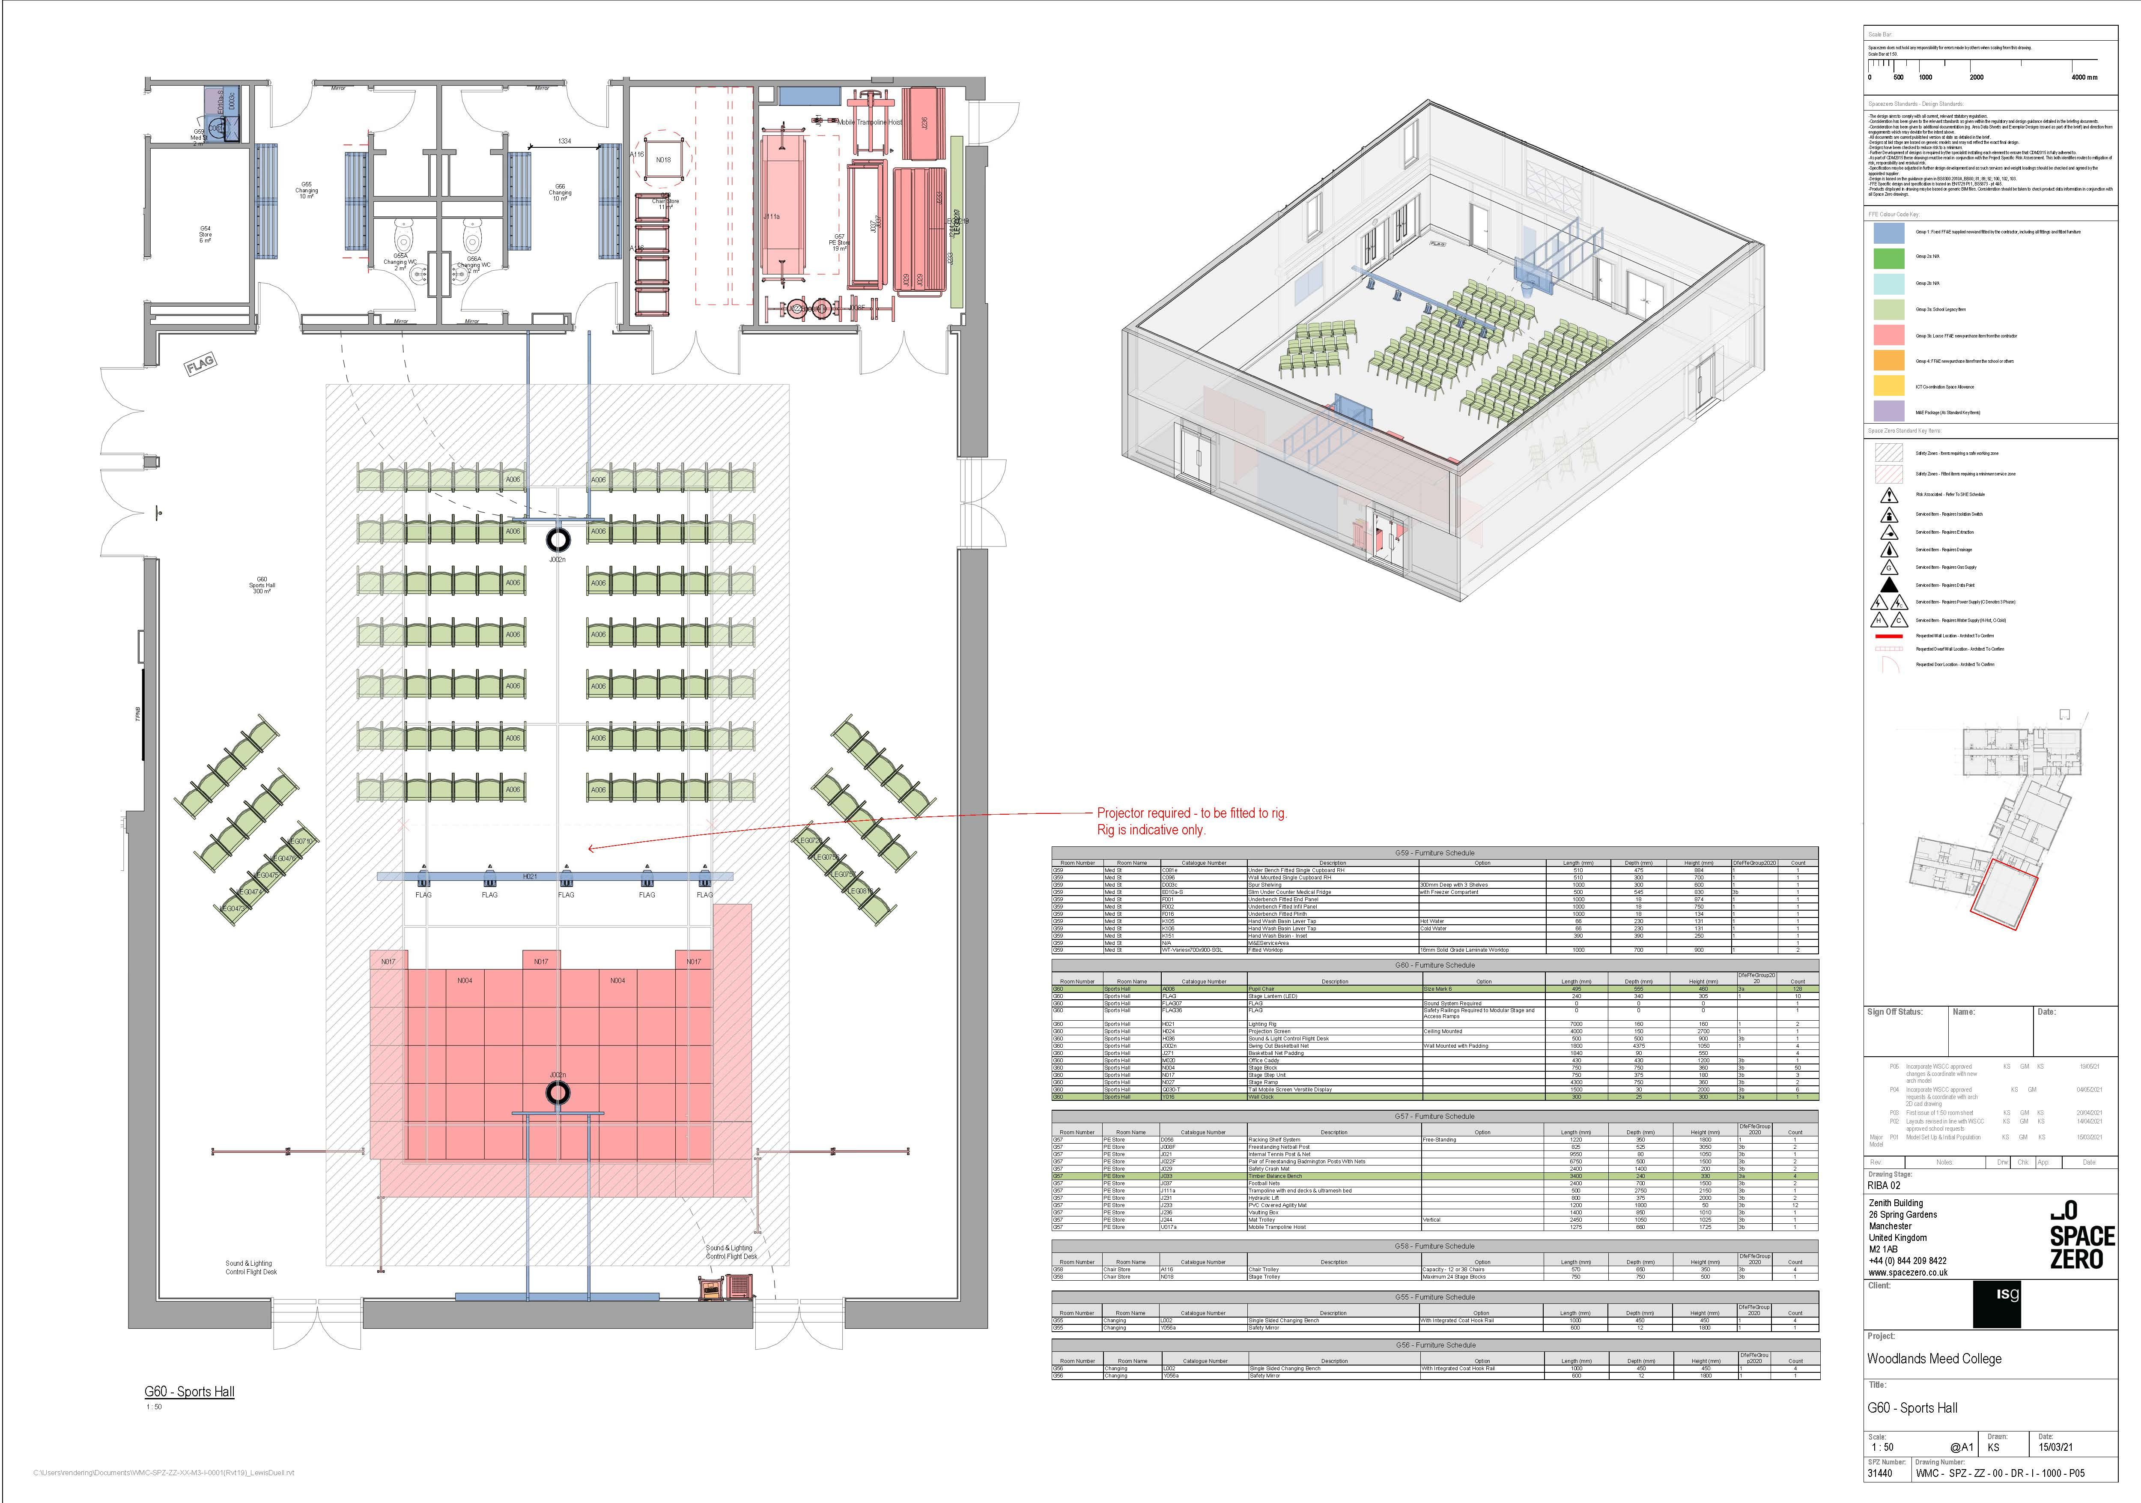
2-Court Sports Hall

Slide 20
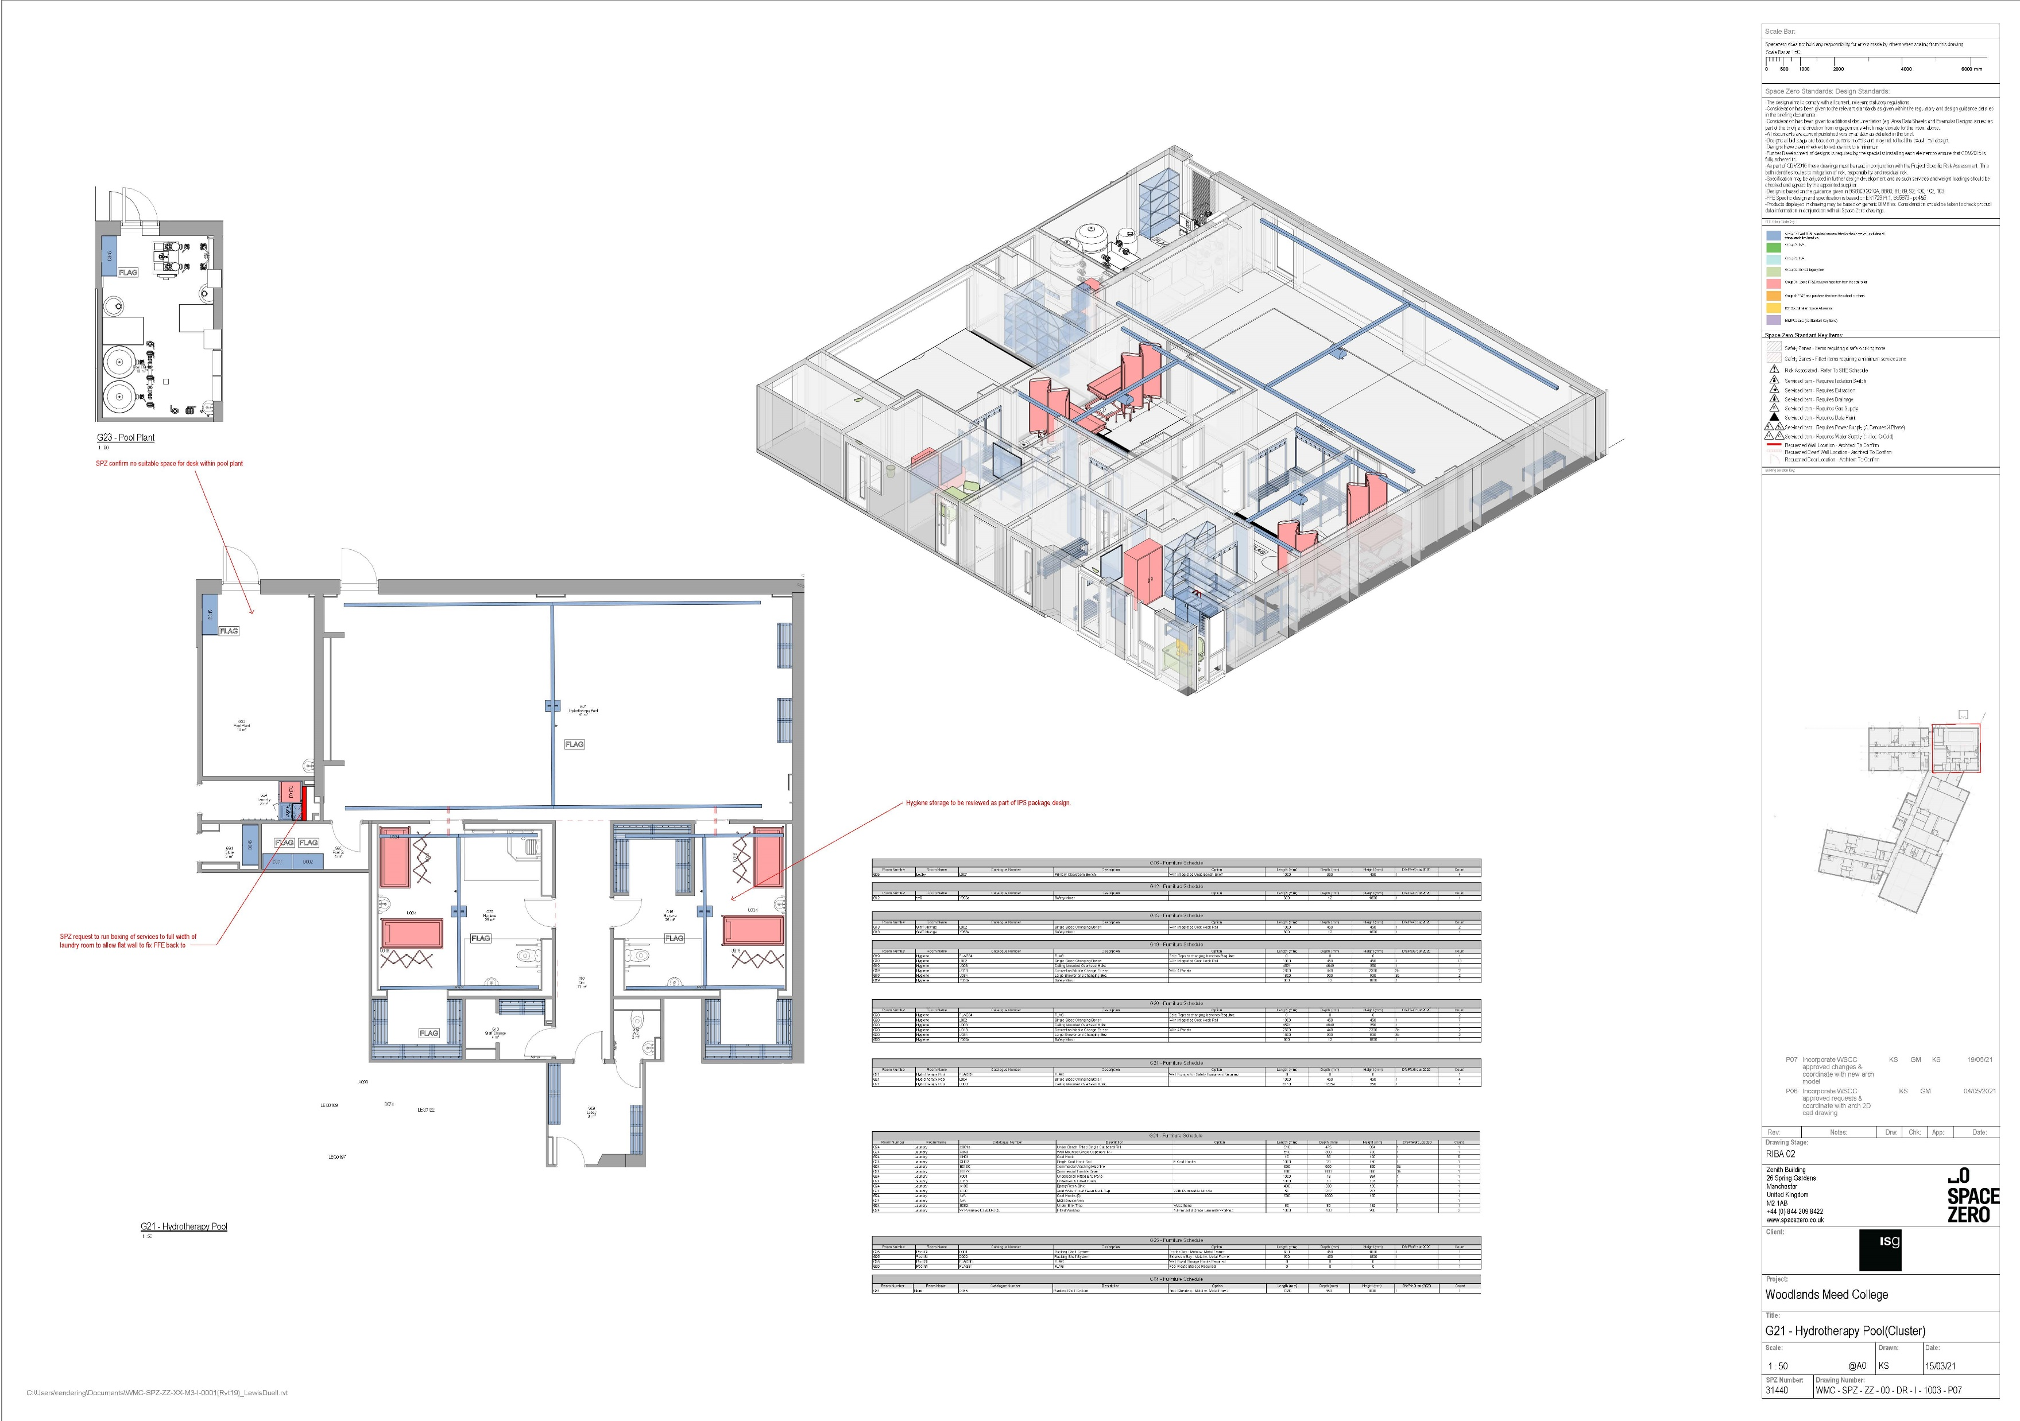
Hydrotherapy Area

Slide 21
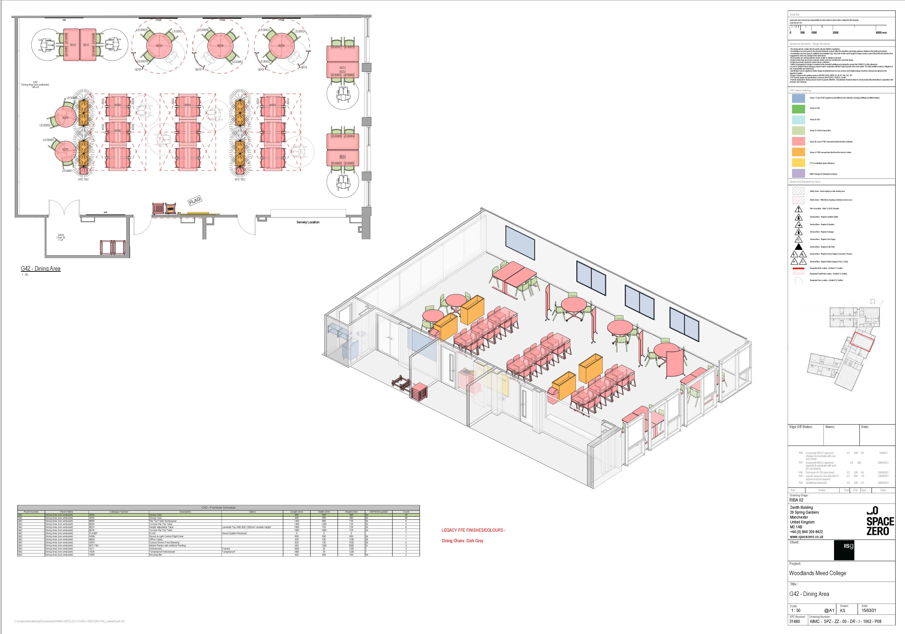
Dining Area

Slide 22
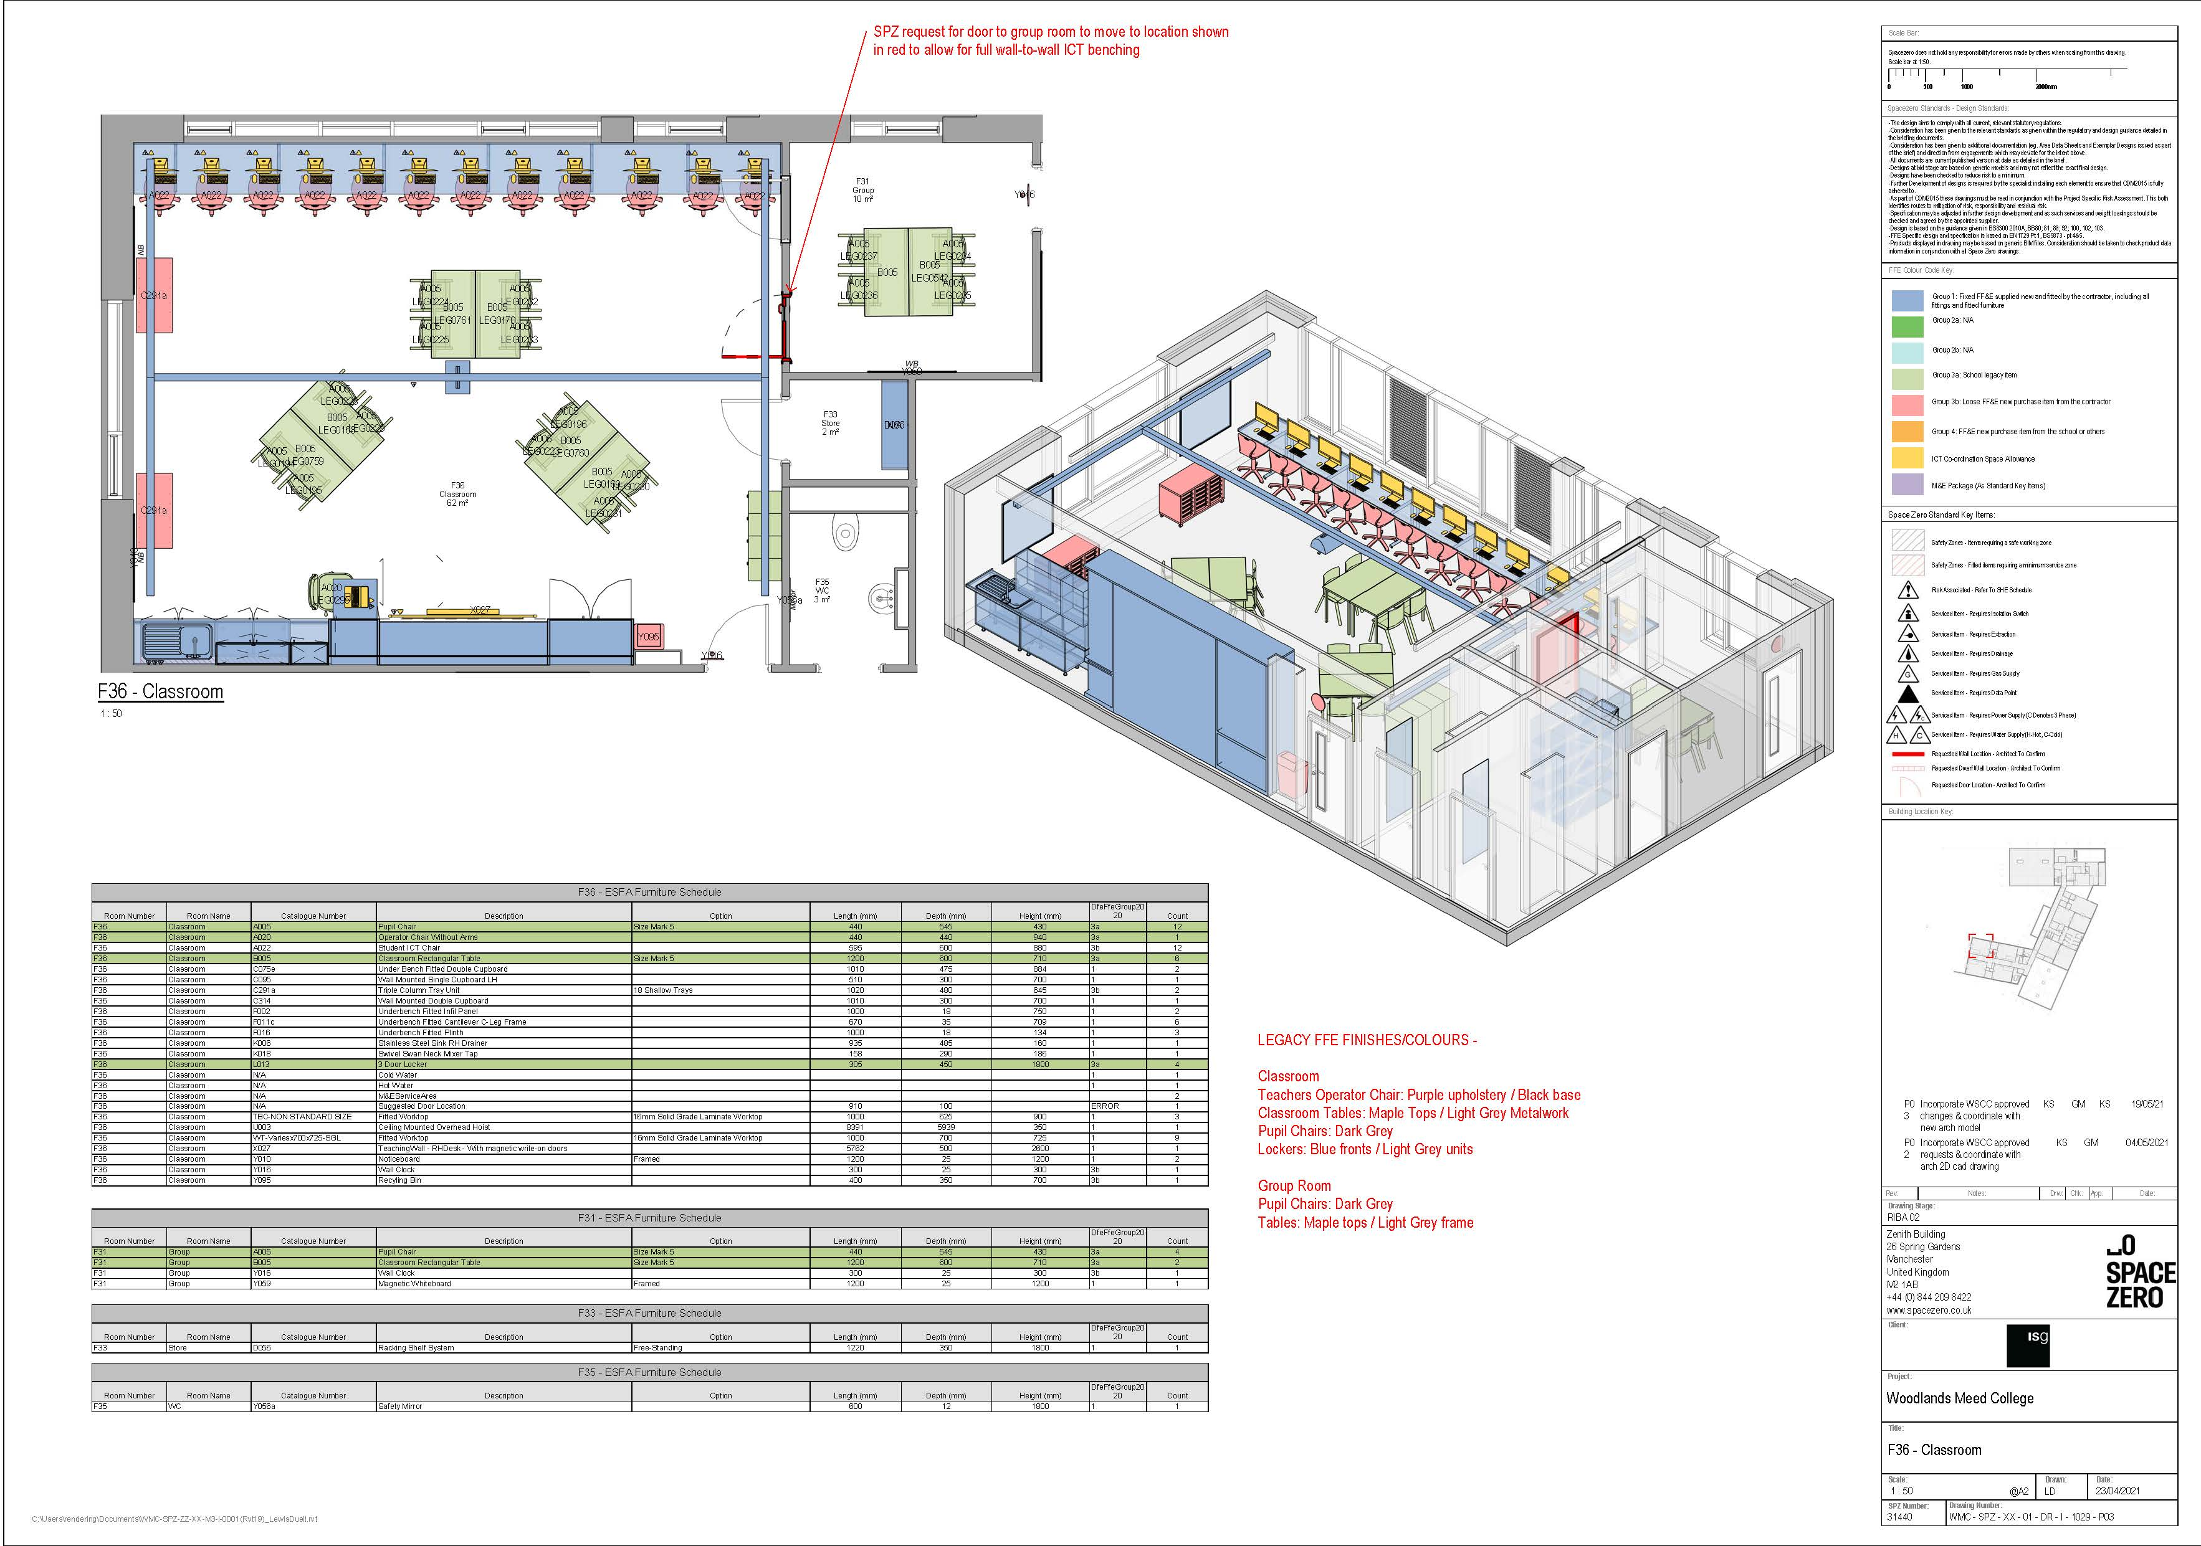
General Classroom

Slide 23
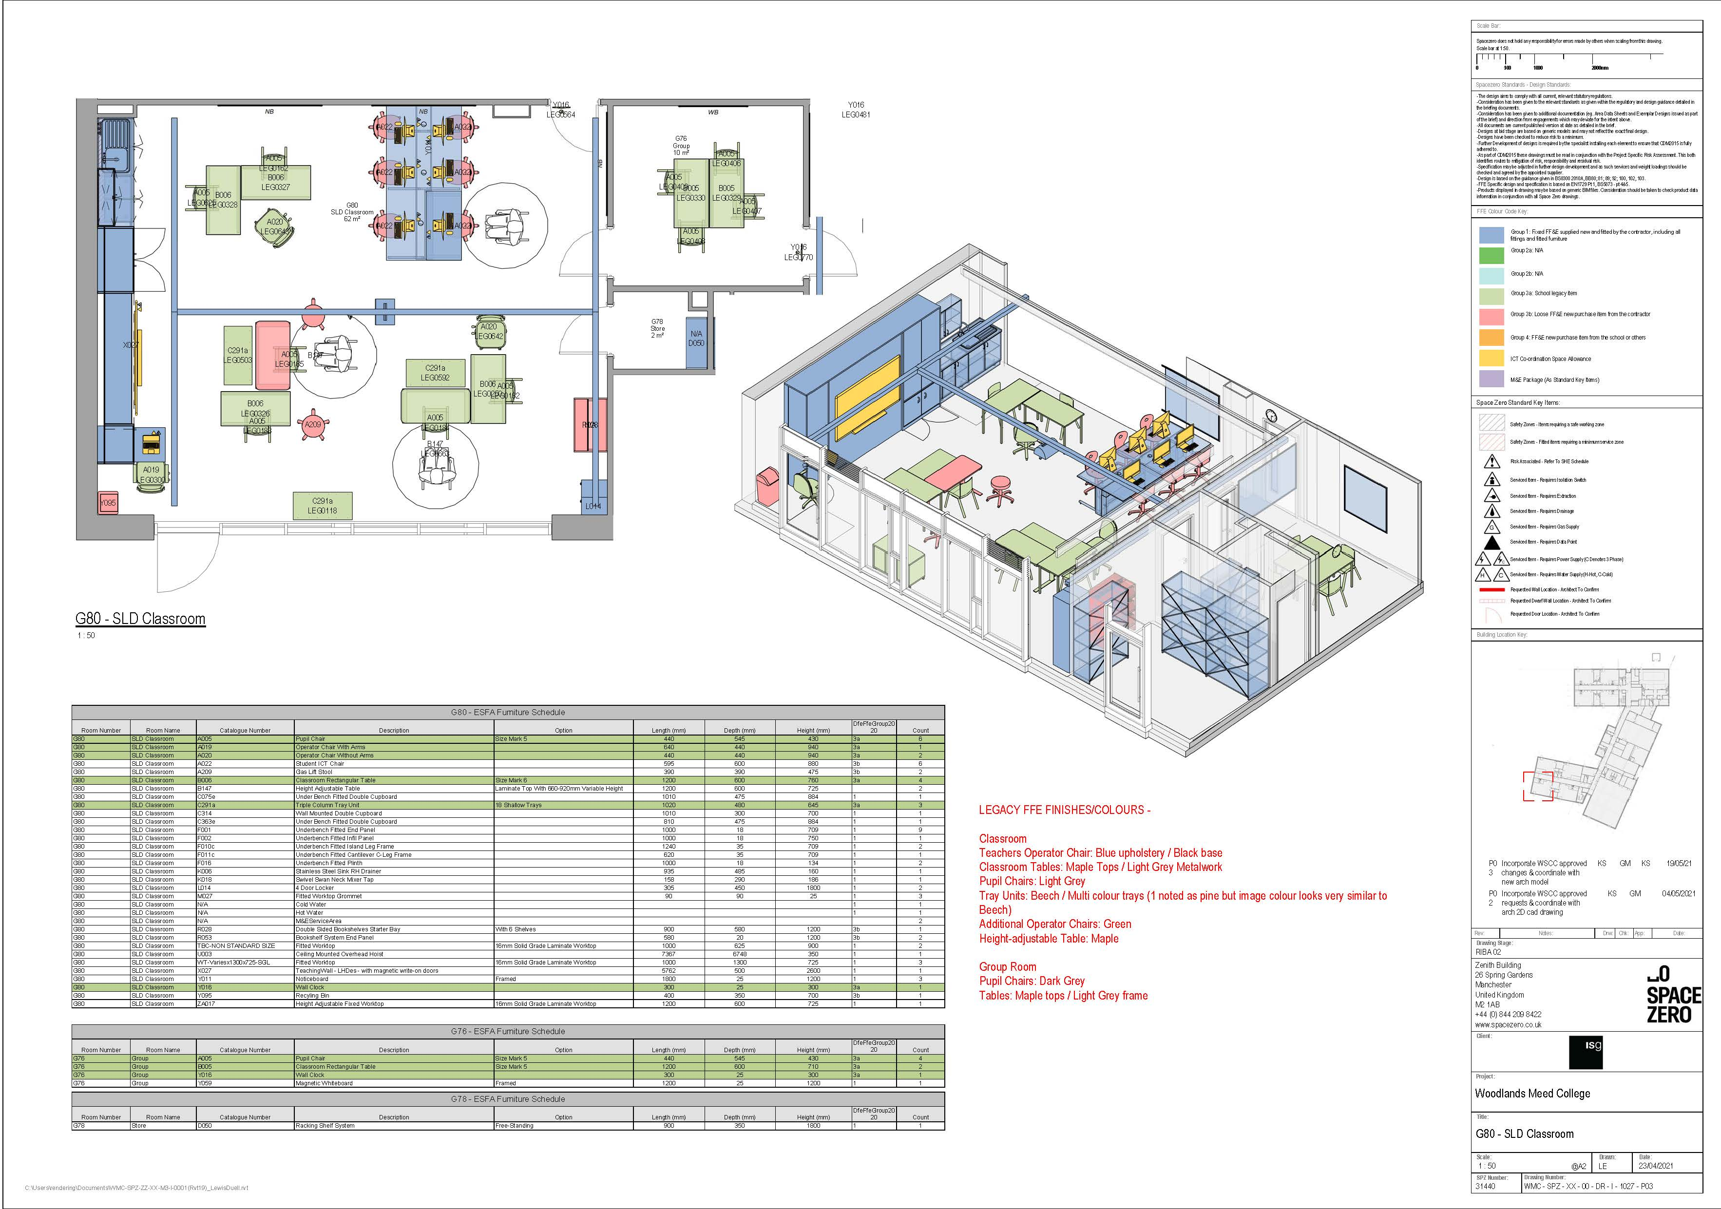
SLD Classroom

Slide 24
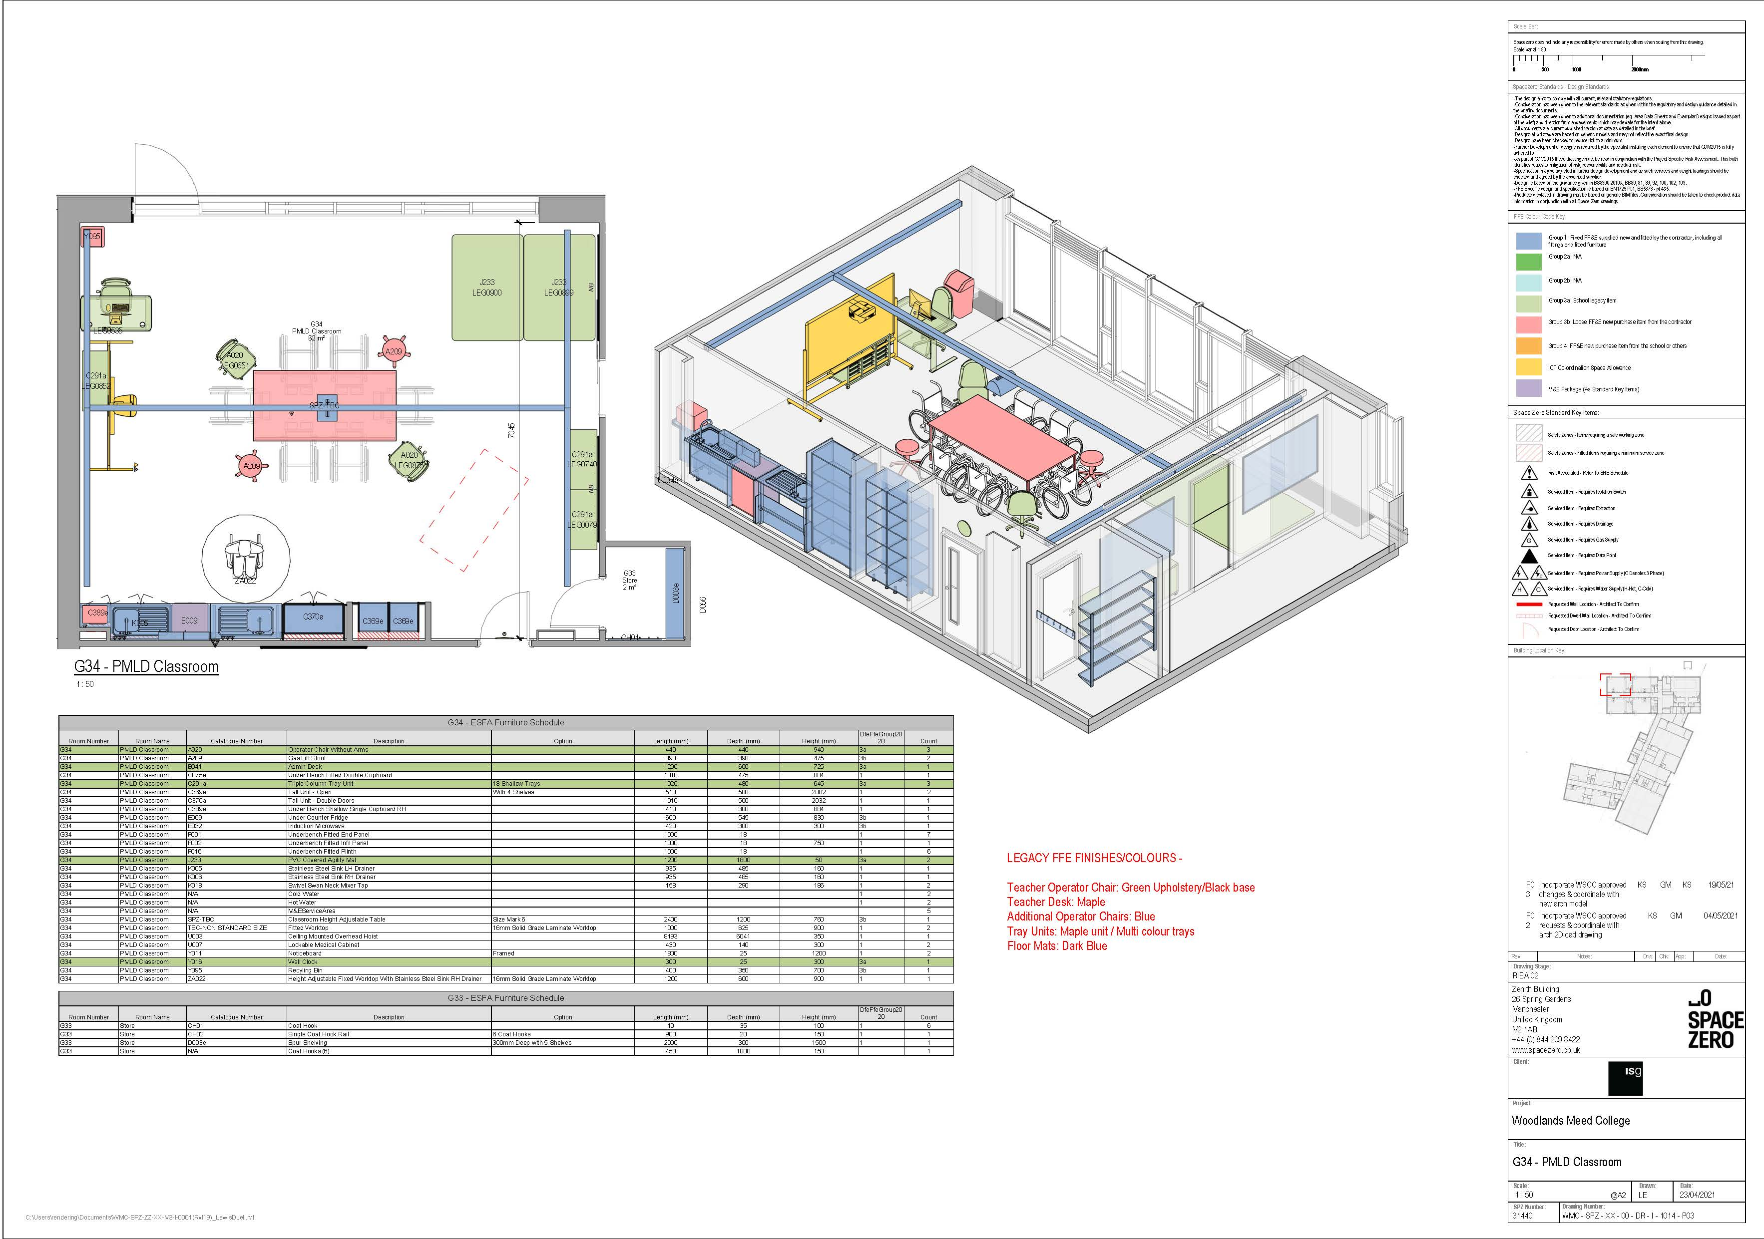
PMLD Classroom

Slide 25
Project Programme
4th November: Completion of Development Agreement and Associated Documents
5th November: Issue of Letter of Acceptance to ISG
Early December: ISG Start in Site
May 23: Completion of Main Buildings
November 23: Completion of external works

Slide 26
Summary
A design that complies with current standards
A project that is fully funded
A project that can be completed by November 23 with occupation of the main build in May 23
A project that is being offered on fair and reasonable terms.

Slide 27
Questions

Slide 28
Closing Comments

